Slide 1
COMP6115 Object Oriented Analysis and Design Session #9

Slide 2
Data Management Layer Design

Slide 3
Learning Outcomes
LO1: Identify the basic concept of advance topic in
Object Oriented Analysis and Design
LO2 : Use the knowledge to develop documentation
for object oriented software analysis and
design using Unified Modelling Language
LO3 : Analyze any problem in any software
application and find out the alternative
solutions using object oriented analysis and
design approach

Slide 4
Chapter 9: Data Management Layer Design

Slide 5
Objectives
Become familiar with several object-persistence formats.
Be able to map problem domain objects to different object-persistence formats.
Be able to apply the steps of normalization to a relational database.
Be able to optimize a relational database for object storage and access.
Become familiar with indexes for relational databases.
Be able to estimate the size of a relational database.
Understand the effect of nonfunctional requirements on the data management layer
Be able to design the data access and manipulation classes.

Slide 6
Introduction
Applications are of little use without data
Data must be stored and accessed efficiently
The data management layer includes:
Data access and manipulation logic
Storage design
Four-step design approach:
Selecting the format of the storage
Mapping problem-domain objects to object persistence format
Optimizing the object persistence format
Designing the data access & manipulation classes

Slide 7
Object Persistence Formats
Files (sequential and random access)
Object-oriented databases
Object-relational databases
Relational databases
“NoSQL” data stores

Slide 8
Electronic Files
Sequential access files
Operations (read, write and search) are conducted one record after another (in sequence)
Efficient for report writing
Inefficient for searching (an average of 50% of records have to be accessed for each search)
Unordered files add records to the end of the file
Ordered files are sorted, but additions & deletions require additional maintenance
Random access files
Efficient for operations (read, write and search)
Inefficient for report writing

Slide 9
Application File Types
Master Files
Store core information (e.g., order and customer data)
Usually held for long periods
Changes require new programs
Look-up files (e.g., zip codes with city and state names)
Transaction files
Information used to update a master file
Can be deleted once master file is updated
Audit file—records data before & after changes
History file—archives of past transactions

Slide 10
Relational Databases
Most popular way to store data for applications
Consists of a collection of tables
Primary key uniquely identifies each row
Foreign keys establish relationships between tables
Referential integrity ensures records in different tables are matched properly
Example: you cannot enter an order for a customer that does not exist
Structured Query Language (SQL) is used to access the data
Operates on complete tables vs. individual records
Allows joining tables together to obtain matched data

Slide 11
Object-Relational Databases
A relational database with ability to store objects
Accomplished using user-defined data types
SQL extended to handle complex data types
Support for inheritance varies

Slide 12
Object-Oriented Databases
Two approaches:
Add persistence extensions to OO programming language
Create a separate OO database
Utilize extents—a collection of instances of a class
Each class is uniquely identified with an Object ID
Object ID is also used to relate classes together (foreign key not necessary)
Inheritance is supported but is language dependent
Represent a small market share due to its steep learning curve

Slide 13
NoSQL Data Stores
Newest type; used primarily for complex data types
Does not support SQL
No standards exist
Support very fast queries
Data may not be consistent since there are no locking mechanisms
Types
Key-value data stores
Document data stores
Columnar data stores
Immaturity of technology prevents traditional business application support

Slide 14
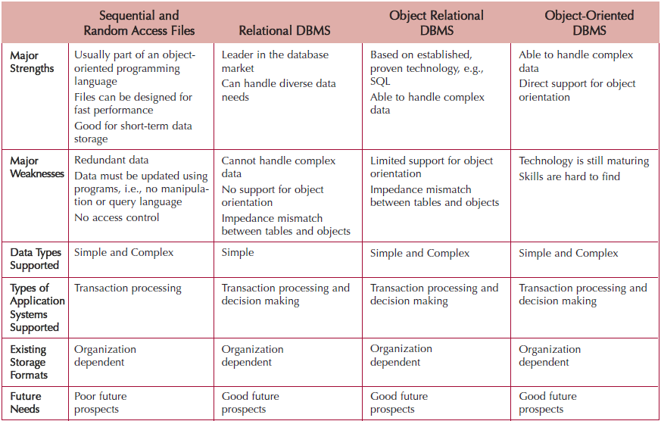
Selecting Persistence Formats

Slide 15
Mapping Problem-Domain Objects to Object-Persistence Formats
Map objects to an OODBMS format
Each concrete class has a corresponding object persistence class
Add a data access and manipulation class to control the interaction
Map objects to an ORDBMS format
Procedure depends on the level of support for object orientation by the ORDBMS
Map objects to an RDBMS format

Slide 16
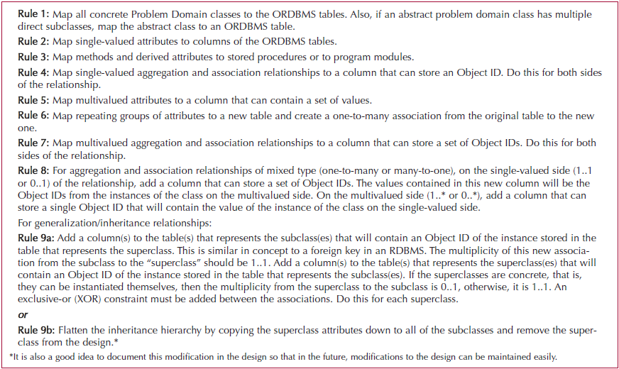
Mapping to an ORDBMS

Slide 17
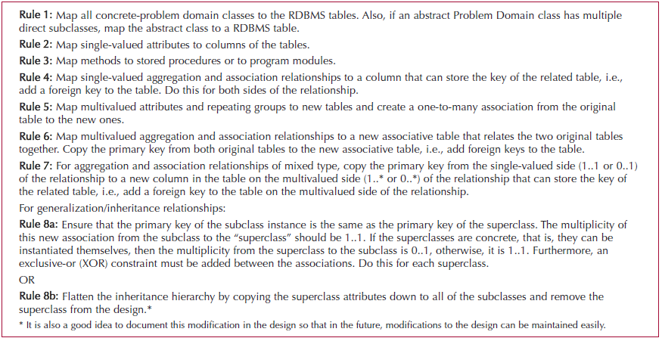
Mapping to an RDBMS

Slide 18
Optimizing RDBMS- Based Object Storage
Primary (often conflicting) dimensions:
Improve storage efficiency
Normalize the tables
Reduce redundant data and the occurrence of null values
Improve speed of access
De-normalize some tables to reduce processing time
Place similar records together (clustering)
Add indexes to quickly locate records

Slide 19
Normalization
Store each data fact only once in the database
Reduces data redundancies and chances of errors
First four levels of normalization are
0 Normal Form: normalization rules not applied
1 Normal Form: no multi-valued attributes (each cell has only a single value)
2 Normal Form: no partial dependencies (non-key fields depend on the entire primary key, not just part of it)
3 Normal Form: no transitive dependencies (non-key fields do not depend on other non-key fields)

Slide 20
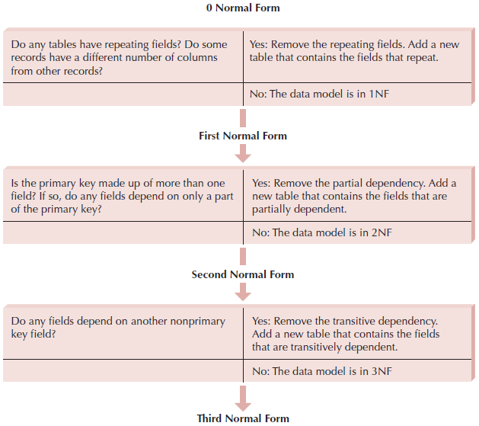
Steps of Normalization

Slide 21
Optimizing Data Access Speed
De-normalization
Table joins require processing
Add some data to a table to reduce the number of joins required (Increases data retrieval speed)
Creates redundancy and should be used sparingly
Clustering
Place similar records close together on the disk
Reduces the time needed to access the disk

Slide 22
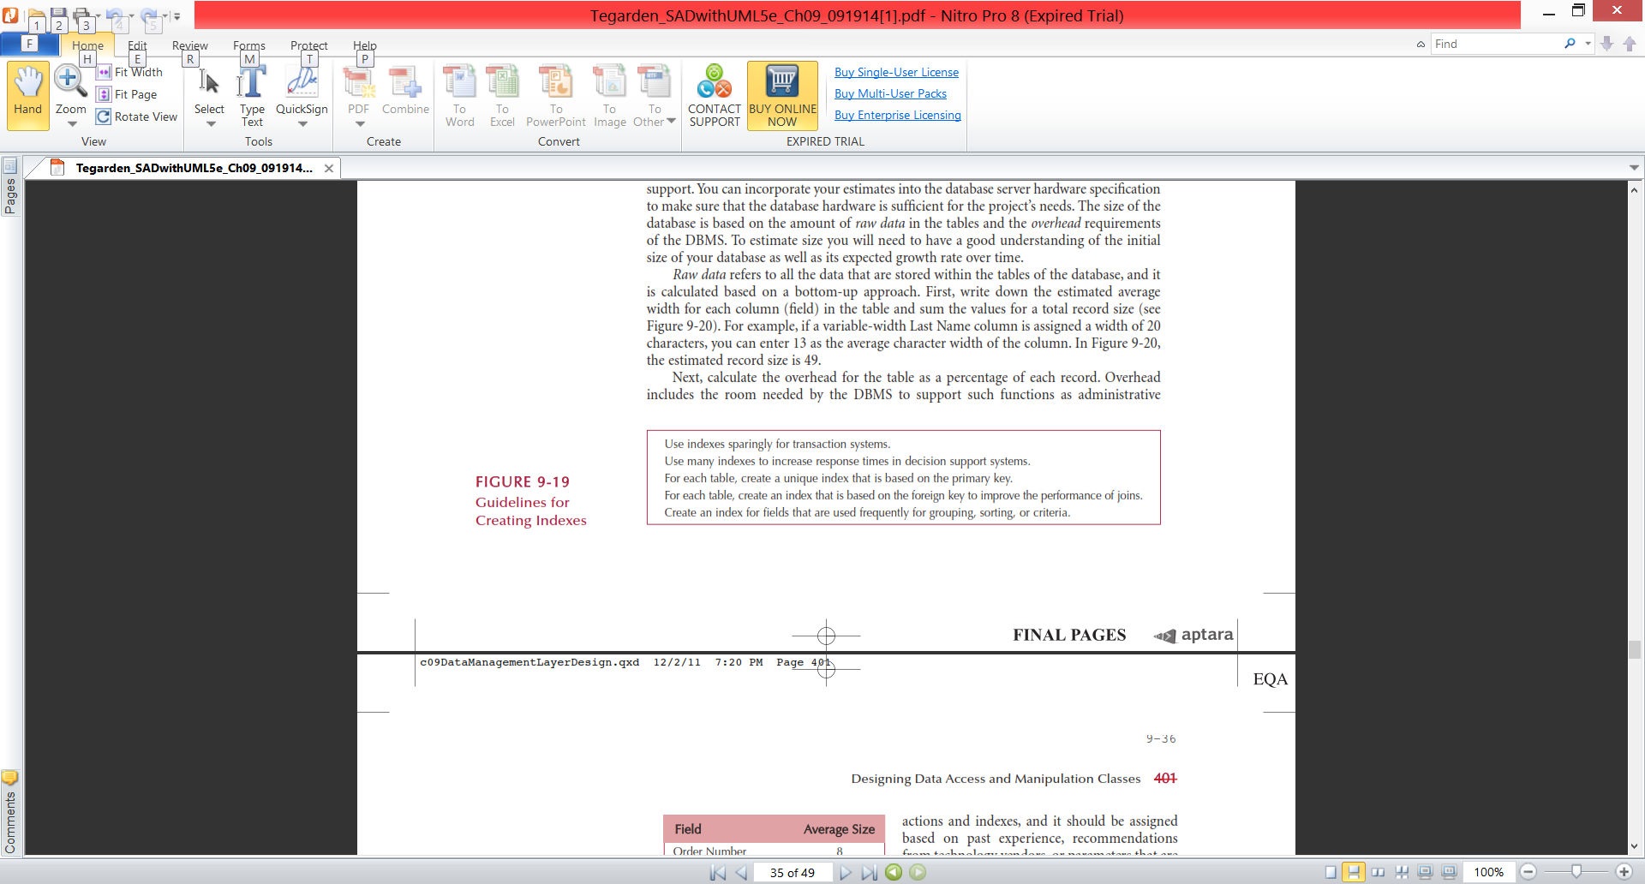
Optimizing Data Access Speed (cont.)
Indexing
A small file with attribute values and a pointer to the record on the disk
Search the index file for an entry, then go to the disk to retrieve the record
Accessing a file in memory is much faster than searching a disk

Slide 23
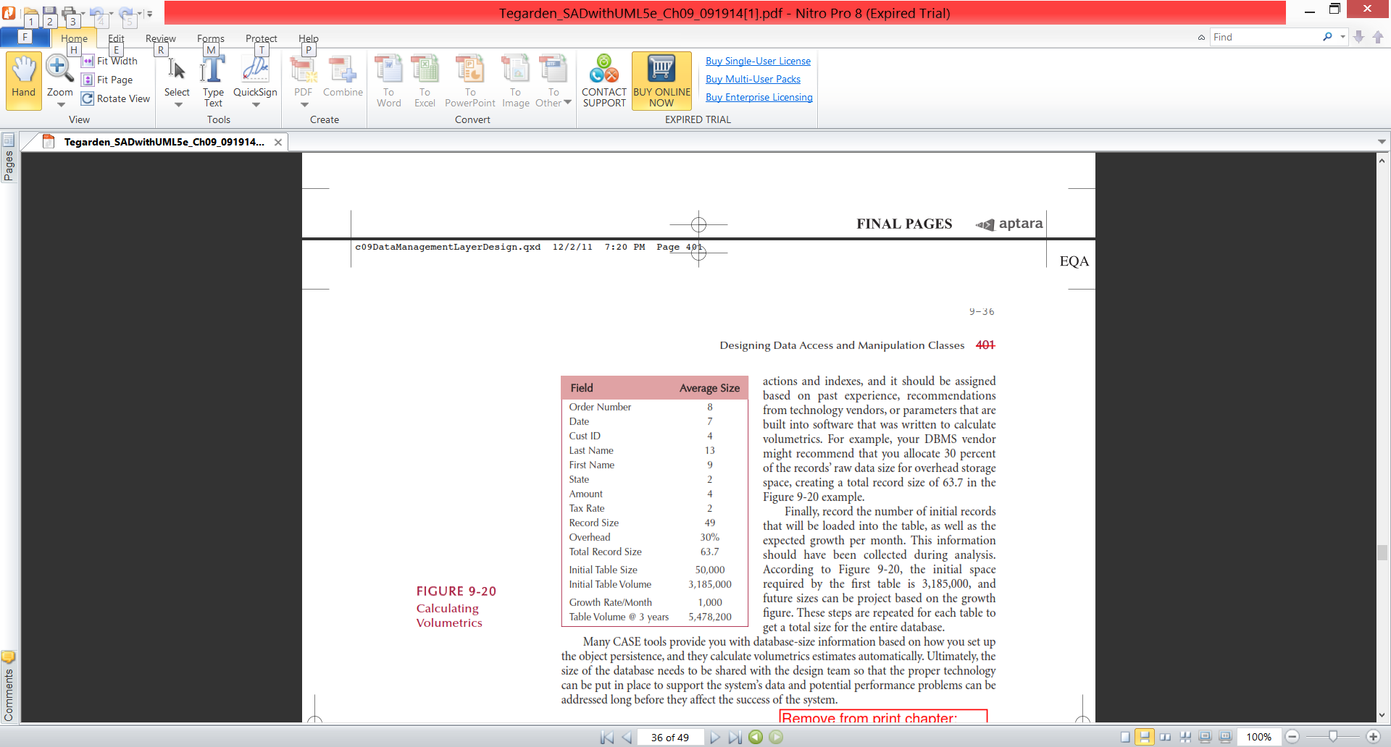
Optimizing Data Access Storage
Estimating Data Storage Size
Use volumetrics to estimate
amount of raw data + overhead requirements
This helps determine the necessary hardware capacity

Slide 24
Designing Data Access & Manipulation Classes
Classes that translate between the problem domain classes and object persistent classes
ORDBMS: create one DAM for each concrete PD class
RDBMS: may require more classes since data is spread over more tables
Class libraries (e.g., Hibernate) are available to help

Slide 25
Nonfunctional Requirements & Data Management Layer Design
Operational requirements: affected by choice in hardware and operating system
Performance requirements: speed & capacity issues
Security requirements: access controls, encryption, and backup
Cultural & political requirements: may affect the data storage (e.g., expected number of characters for data field, required format of a data field, local laws pertaining to data storage, etc…)

Slide 26
VERIFYING AND VALIDATING THE DATA MANAGEMENT LAYER
Test the fidelity of the design before implementation
Verifying and validating the design of the data management layer falls into three basic groups:
Verifying and validating any changes made to the problem domain
Dependency of the object persistence instances on the problem domain must be enforced
The design of the data access and manipulation classes need to be tested

Slide 27
Summary
Object Persistence Formats
Mapping Problem-Domain Objects to Object-Persistence Formats
Optimizing RDBMS-Based Object Storage
Nonfunctional Requirements and Data Management Layer Design
Designing Data Access and Manipulation Classes
Nonfunctional Requirements & Data Management Layer Design
Verifying and validating the data management layer

Slide 28
References
Denis, Wixom,Tegarden. (2015). Systems Analysis and Design: An Object-Oriented Approach with UML. 5th edition. ISBN: 978-1-118-80467-4, John Wiley & Sons, Inc, Denver (USA)

